Slide 1


Mooc 2.1
Xin Zhang
Shuangke Li

Slide 2
Motivation
Challenge in Online Course Search
Have career goal but don’t know what courses or skills to look for
Some related courses may not fit into career requirements anymore
Our solution:
Website for helping users find online courses based on job requirements

Slide 3
Architecture overview
Job Information Resource
Course Information Resource
API Calls
Data Collections
Build /Update
Build/Update
Job Cluster
Input
Course Matching Model
Output
Course List
Keywords Matching
Display
Website

Slide 4
Course Matching Model Building Process Overview
Data Cleaning
Job Clustering
Keyword Extraction
Keyword List Matching

Slide 5
Course Matching Model Data Cleaning
Data Format:
Job Post (16048 job posts):
Job Title
Job Description
Job Requirement
Sources: Career Builder Google Career Site Yahoo Career Center
Course Information (12084 courses):
Course Title
Course Description
Sources: edX Udacity Coursera
Data Cleaning:
Remove URLs
Clean punctuations and special characters
Remove HTML tags
Spell Check
Data Cleaning
Job Clustering
Keyword Extraction
Keyword List Matching

Slide 6
Course Matching Model Job Clustering
Why job clustering?
Similar jobs may have different titles
e.g. Software Engineer, Software Developer, Software Development Engineer
Filter out unpopular key words for job requirements
e.g. English skills in a software engineer job
Data Cleaning
Job Clustering
How to do job clustering?
Glove(Global Vectors for Word Representation) for word embedding on Job Descriptions (N*200 matrix)
DBSCAN(Density-based spatial clustering of applications with noise) for Clustering vectorized job descriptions
Keyword Extraction
Keyword List Matching

Slide 7
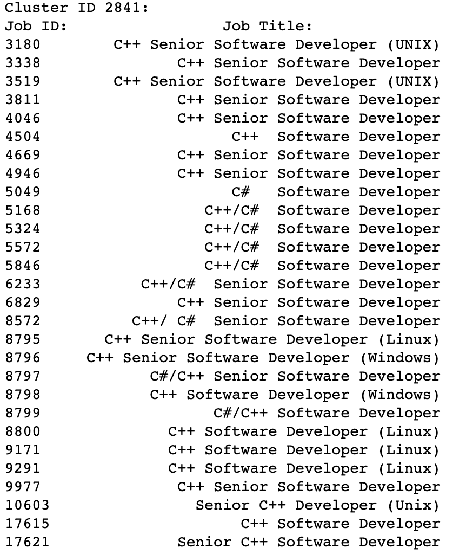
Course Matching Model Job Clustering - example

Slide 8
Course Matching Model Keyword Extraction
Create terms in Unigram and Bigram
Convert sentences into directed graph.
Current Term: Node
Previous Term: Incoming edges
Next Term: Outcoming edges
Collect Term features:
In Degree
Out Degree
Degree
Frequency
Average Location score
TF-IDF Score
Title Score (frequency in titles)
HITS Ranking Algorithm
Data Cleaning
Job Clustering
Keyword Extraction
Keyword List Matching

Slide 9
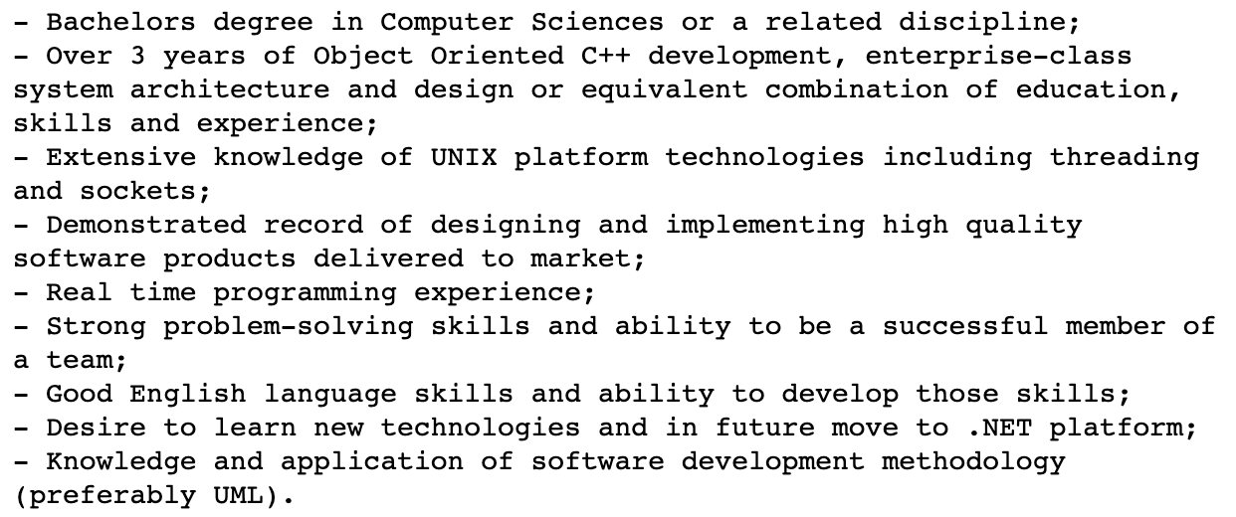
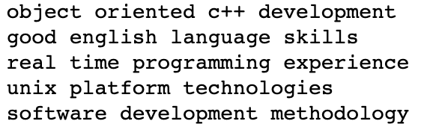
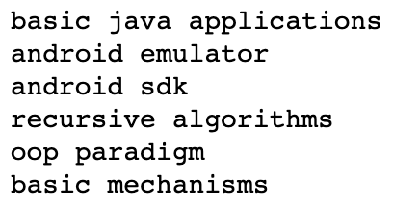
Course Matching Model Keyword Extraction - example
Job Post: C++ Software Engineer
Course Description: 'Java Fundamentals for Android Development'

Slide 10
Course Matching Model Keyword List Matching
Data Cleaning
Select top key words extracted from job requirements for each job cluster
Use TF-IDF values to vectorize keyword list from job requirements of job clusters and course descriptions.
Use cosine similarity to measure the closeness of course content and job cluster requirements
Job Clustering
Keyword Extraction
Keyword List Matching

Slide 11
User Input
Rank job titles based on edit distance between user input and job titles using Jaro Winkler Distance Score (0 to 1).
Job Title
Software Engineer: 1
User Input
Software Engineer
Software Developer: 0.8745098039215686
Accountant:
0.46470588235294114

Slide 12
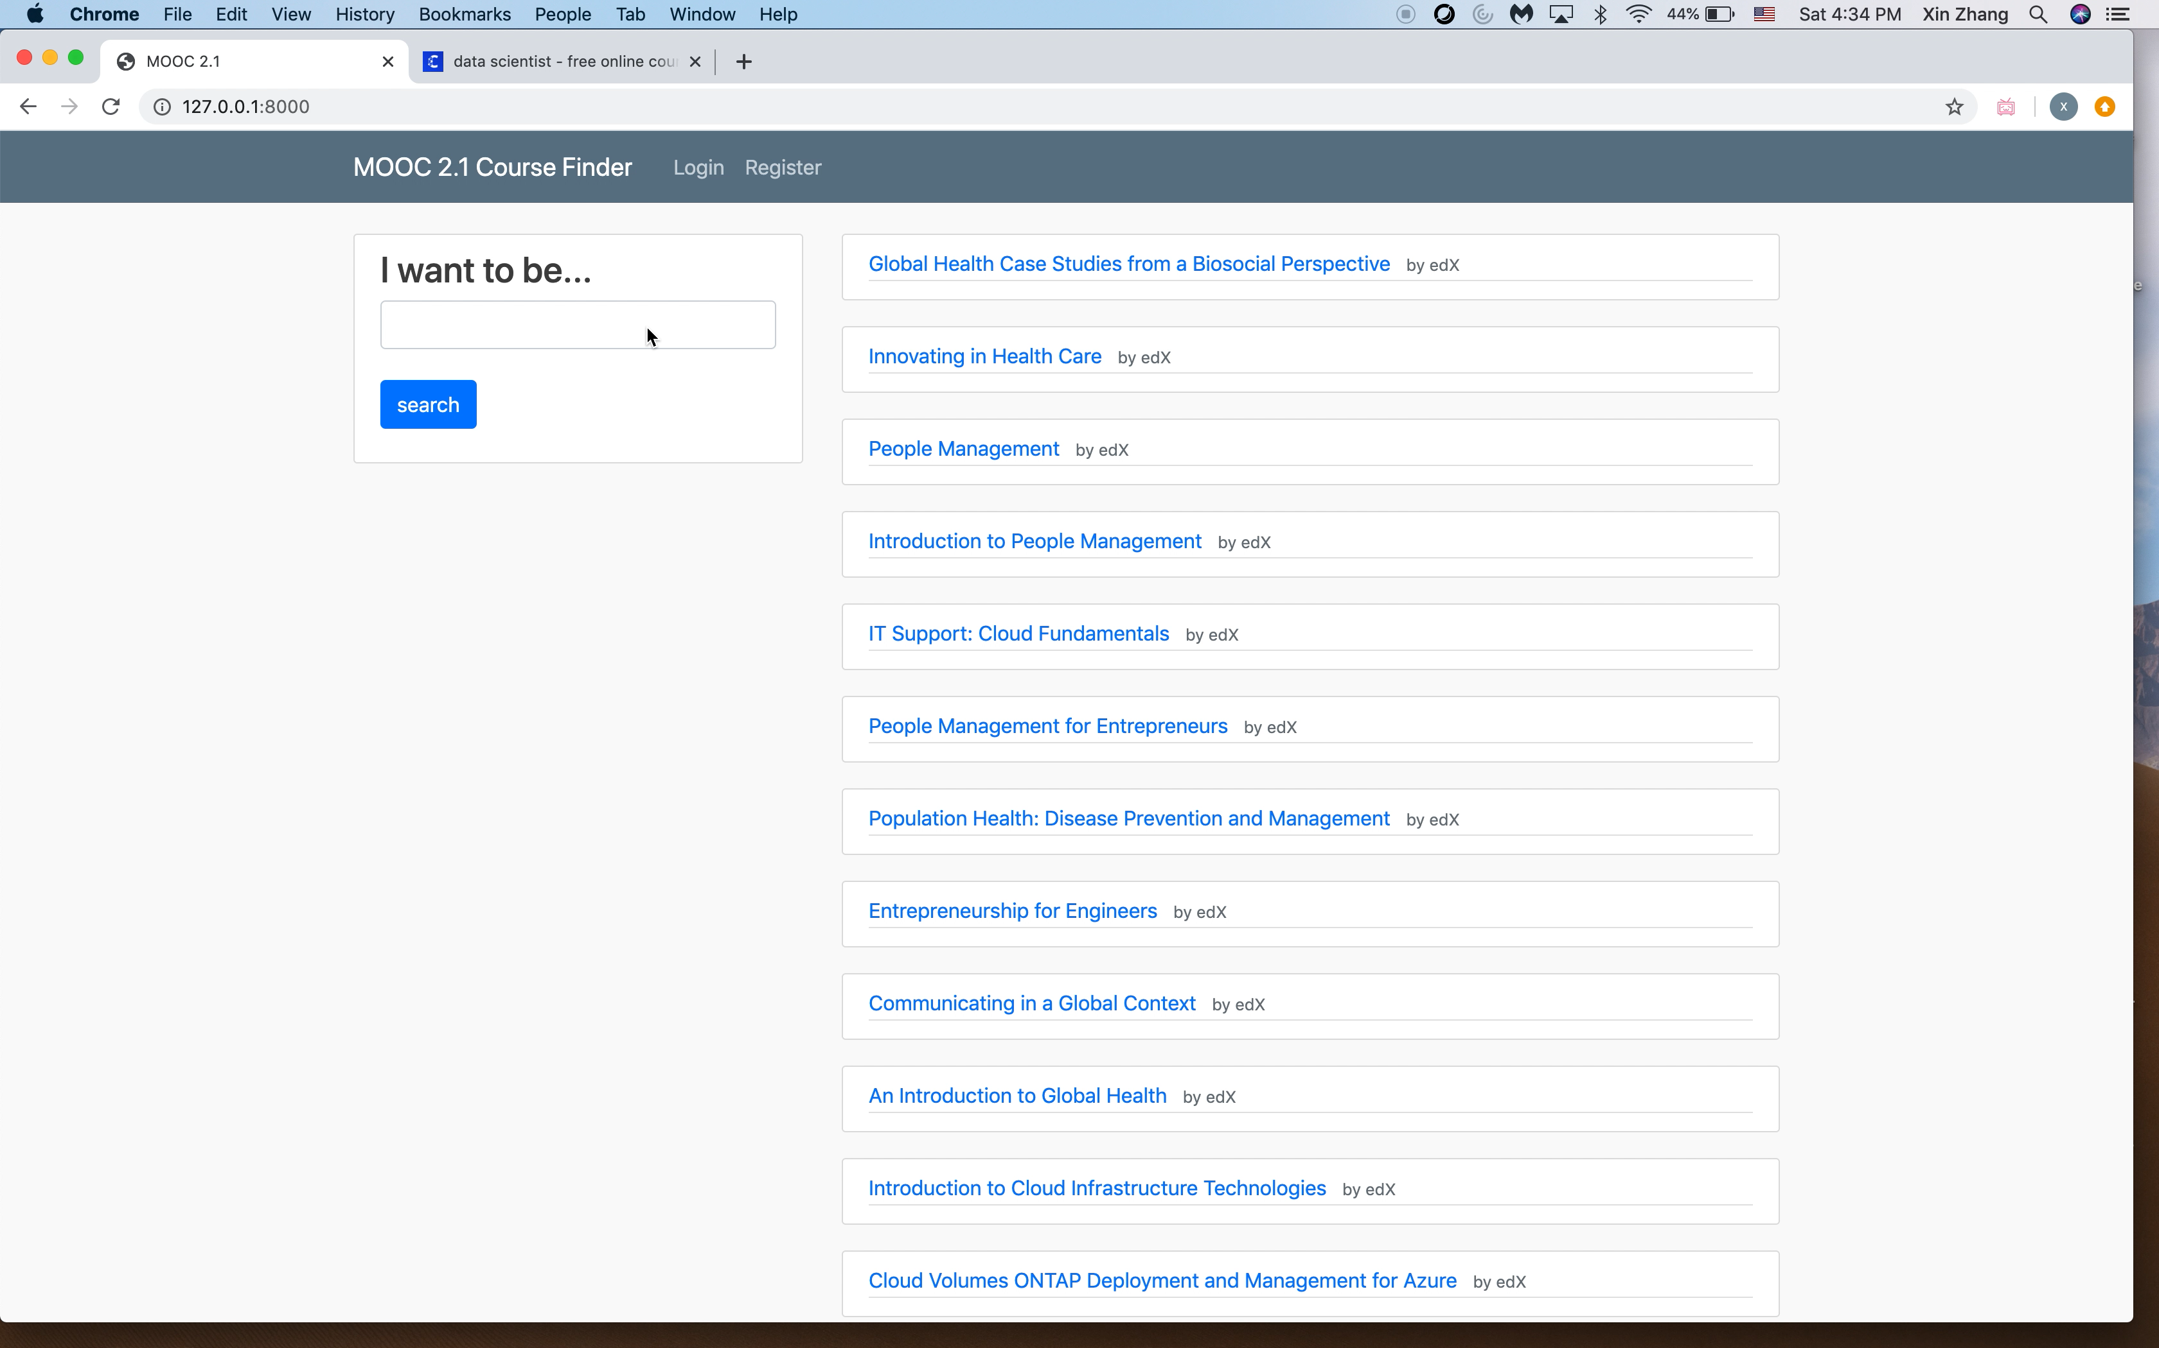
Demo

Slide 13
Future Work
Adding more data resources (online job post and online courses resource)
Improving course matching algorithm based on user behavior e.g. courses taken with certain searched jobs.

Slide 14
Reference
Pennington, J. (n.d.). GloVe: Global Vectors for Word Representation. Retrieved March 10, 2020, from https://nlp.stanford.edu/projects/glove/
Lutins, E. (2017, September 15). DBSCAN: What is it? When to Use it? How to use it. Retrieved March 10, 2020, from https://medium.com/@elutins/dbscan-what-is-it-when-to-use-it-how-to-use-it-8bd506293818
Litvak, M., & Last, M. (n.d.). Graph-Based Keyword Extraction for Single-Document Summarization. Retrieved April 2, 2020, from https://www.aclweb.org/anthology/W08-1404.pdf
Ma, E. (2018, July 26). 3 basic Distance Measurement in Text Mining. Retrieved March 29, 2020, from https://towardsdatascience.com/3-basic-distance-measurement-in-text-mining-5852becff1d7
Dreßle, K., & Ngom, A.-C. N. (2015, September). On the Efficient Execution of Bounded Jaro-Winkler Distances. Retrieved April 4, 2020, from https://www.researchgate.net/publication/281550860_On_the_Efficient_Execution_of_Bounded_Jaro-Winkler_Distances

